Slide 1


Data Visualization with Power BI

Slide 2
Course Overview & Expectations
Welcome to the beginner's course on Power BI for Data Analytics! This course is designed to help you build a strong foundation in data visualization and reporting using Microsoft Power BI — one of the leading tools in the business intelligence space.
🧭 What You’ll Learn:
Introduction to Data Visualization
The importance of visualizing data
Best practices and design principles
Getting Started with Power BI
How to install and navigate Power BI Desktop
Overview of its key features and components
Connecting to Data Sources & Cleaning Data
Importing Excel, CSV, SQL, and web data
Using Power Query to clean and prepare data
Creating Interactive Dashboards
Designing reports using visuals
Adding slicers, filters, and tooltips
Publishing & Sharing Reports
Uploading to Power BI Service
Sharing dashboards with teams and stakeholders

Slide 3
Course Overview & Expectations
By the end of this course, you will be able to:
✅ Understand the principles of effective data visualization ✅ Use Power BI to load, clean, and visualize data ✅ Create interactive dashboards and reports ✅ Interpret and communicate insights using visuals ✅ Build your own project or portfolio dashboard
No prior experience required! This course is beginner-friendly. A basic understanding of Excel or data tables is helpful but not necessary.

Slide 4
Topic 1: Getting Started with Visualization in Power BI
What is Data Visualization?
Data Visualization is the art of turning raw data into meaningful visuals — helping users see trends, patterns, and insights that would be hard to spot in tables or text.
Imagine a spreadsheet with 10,000 rows of sales data. Hard to interpret, right? But a line chart or map can quickly show you which regions are performing well and which aren’t.

Slide 5
Topic 1: Getting Started with Visualization in Power BI
🌟 Why Visualization Matters
Quicker Decisions: Executives can make faster choices based on visuals.
Better Communication: Charts tell stories that words can’t.
Error Detection: Spot outliers and anomalies easily.
Engagement: People respond better to visuals than raw numbers.

Slide 6
Topic 1: Getting Started with Visualization in Power BI
📐 Core Principles of Data Visualization
Principle | Explanation
Simplicity | Avoid clutter. Focus on key messages.
Relevance | Only show data that supports your point.
Consistency | Use uniform colors, fonts, and labels.
Clarity | Make visuals self-explanatory. Use legends and labels.
Interactivity | Allow users to explore data (e.g., slicers, filters).

Slide 7
Topic 1: Installing Power BI
🔧 What is Power BI?
Power BI is a powerful, user-friendly tool by Microsoft that allows you to:
Import and transform data
Create interactive dashboards
Share insights across your organization
📥 How to Install Power BI Desktop
Option 1: Microsoft Store (Recommended)
Open Microsoft Store on your PC.
Search for “Power BI Desktop”.
Click Get → It will automatically install the latest version.

Slide 8
Topic 1: Installing Power BI
Option 2: From Microsoft’s Website
Visit: https://powerbi.microsoft.com/desktop/
Click Download Free.
Choose your language and OS version.
Install the downloaded file like any other software.
✅ Power BI is free to use for building and testing reports on your local machine. You only need a Pro license if you want to share reports via the cloud.

Slide 9
Topic 1: Getting Started with Visualization in Excel
Principles of a Good Data Visualization
Creating effective visualizations requires following certain principles to ensure clarity, accuracy, and impact. Below are key principles to keep in mind:
Clarity – Keep It Simple & Easy to Understand
A good visualization should communicate insights instantly without requiring too much effort to interpret.
Avoid unnecessary decorations, complex designs, or excessive colors that may distract from the data.
Use clear labels, titles, and legends to guide the audience in understanding the chart.

Slide 10
Topic 1: Getting Started with Visualization in Excel
Principles of a Good Data Visualization
2. Accuracy – Represent Data Truthfully
Always use the right chart type to prevent misinterpretation. For example, a pie chart should only be used when the data represents parts of a whole.
Ensure that axes and scales are consistent to avoid misleading conclusions (e.g., avoid truncating the Y-axis in bar charts, as it can distort comparisons).
Avoid adding unnecessary 3D effects, as they can make it difficult to read accurate values..

Slide 11
Topic 1: Getting Started with Visualization in Excel
Principles of a Good Data Visualization
3. Relevance – Focus on Key Insights
Only include data that is relevant to the audience and the purpose of the visualization.
Remove extra details that do not add value. Too much information in one chart can cause information overload.
Ensure that the visualization answers a key question or tells a meaningful story.

Slide 12
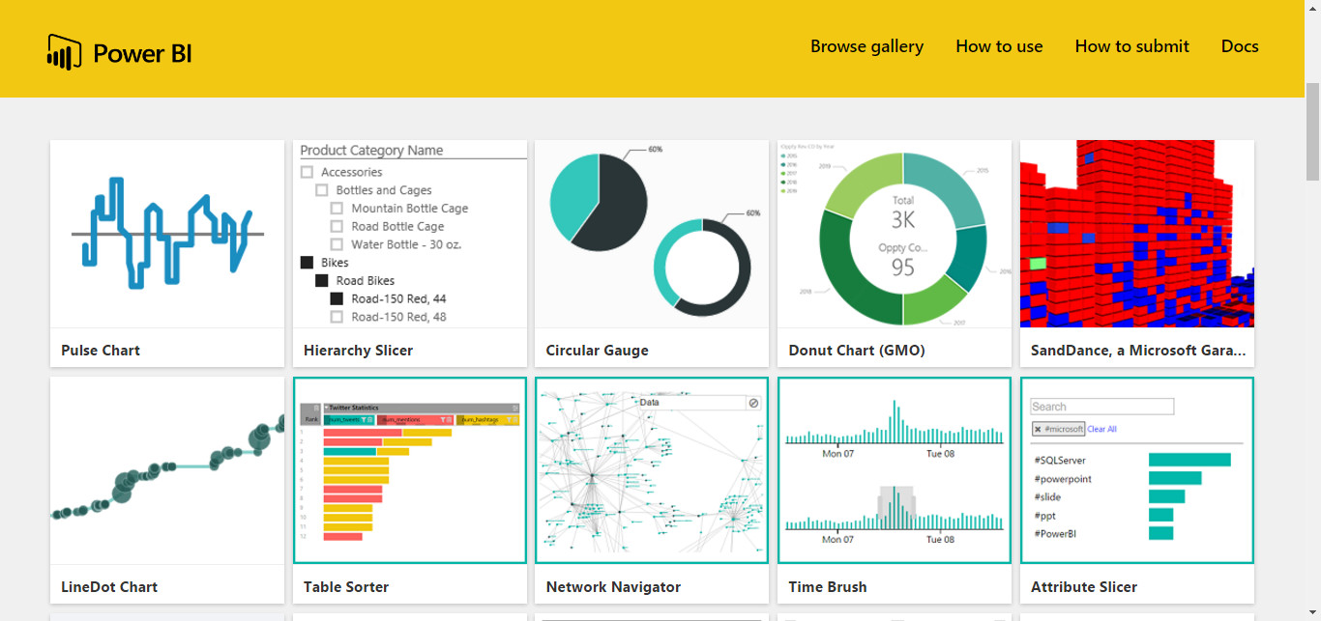
Topic 2: Creating Charts in Power BI

